Slide 1

認識 Nemo

Slide 2
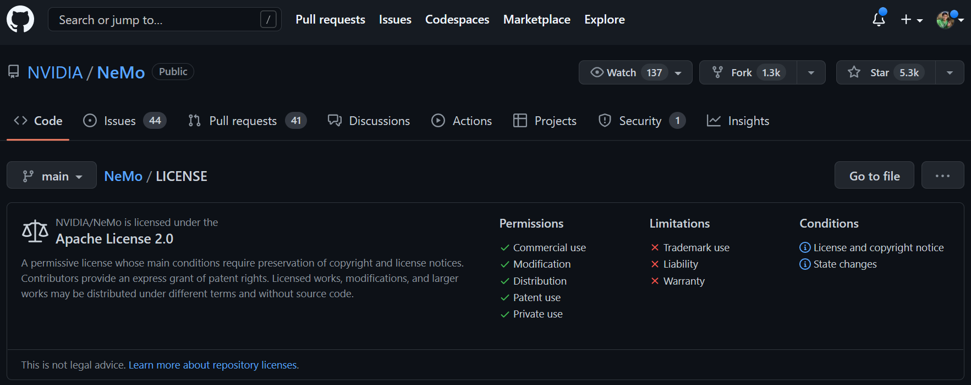
前往：NVIDIA/NeMo: NeMo: a toolkit for conversational AI (github.com)

Slide 3



使用範疇（Key Features）
語音處理（Speech Processing）
語音辨識 - Automatic Speech Recognition (ASR)
自然語言處理（Natural Language Processing）
文字分類 - Text Classification
問答系統 - Question Answering
語音合成（Speech Synthesis）
文字轉語音系統 - Text-to-Speech (TTS)

Slide 4
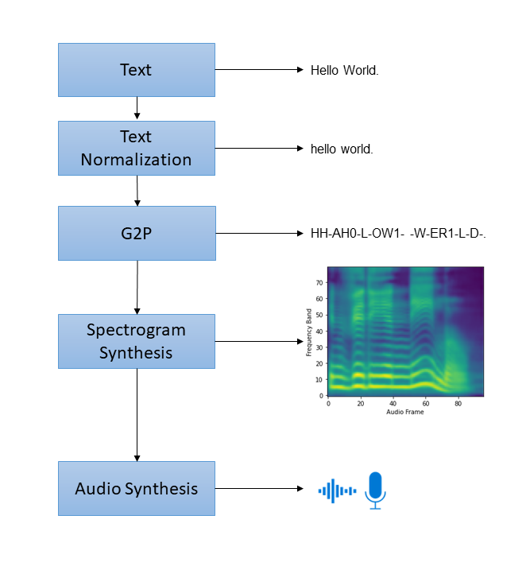
文字轉語音系統 - Text-to-Speech (TTS)
輸入文字
文字預處理 1000 → one thousand
Normalizer
字素（Grapheme） → 音素（Phoneme）
將文字/音素轉換成頻譜（Spectrogram）
Spectrogram Generator
將頻譜轉換成聲音
Vocoder

Slide 5
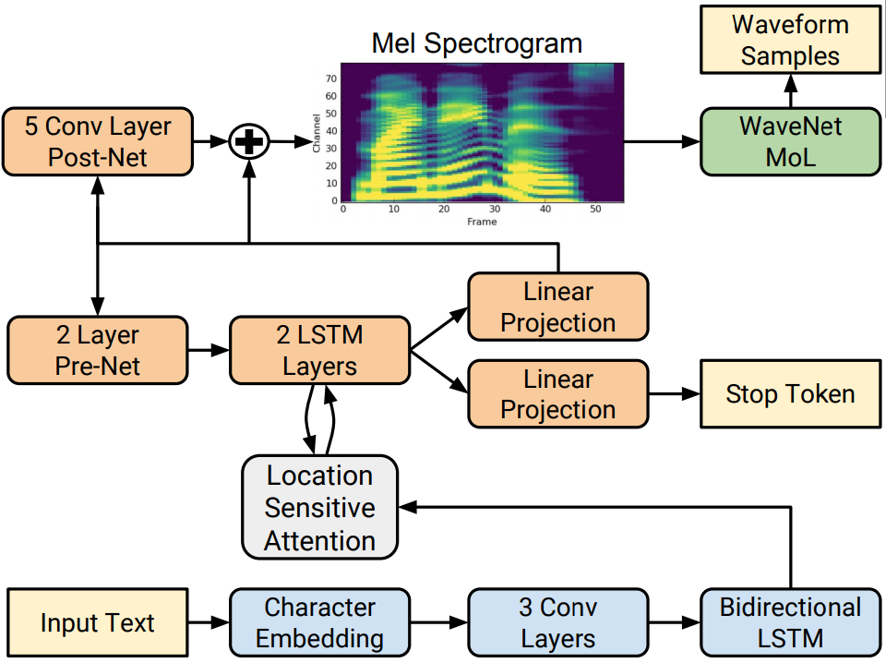
Spectrogram Generator
Encoder
a word embedding
a convolutional network
a bi-directional LSTM
Attention
Location Sensitive Attention Module
Decoder
2 layer LSTM
a convolutional postnet
a fully connected prenet
- - - - - - - - - - - - - - - - - - - - - - - - - - - - - - - - - - -
Tacotron2, FastPitch, Mixertts(x)
(Jonathan Shen et al., 2017)

Slide 6

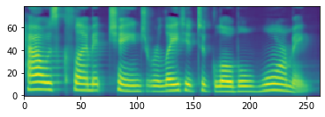
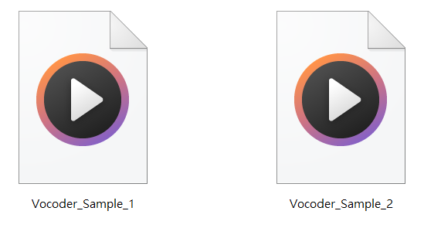

Vocoder
How is climate change related to global warming?
NeMo models contain everything needed to train and reproduce Conversational AI models
WaveGlow, HiFi-GAN, *UnivNet, Griffin-Lim

Slide 7
參考資源
NeMo/NeMo_TTS_Primer.ipynb at main · NVIDIA/NeMo (github.com)
Spectrogram Generator
Tacotron2 [1712.05884] Natural TTS Synthesis by Conditioning WaveNet on Mel Spectrogram Predictions (arxiv.org)
FastPitch: [2006.06873v2] FastPitch: Parallel Text-to-speech with Pitch Prediction (arxiv.org)
Mixer-TTS: [2110.03584] Mixer-TTS: non-autoregressive, fast and compact text-to-speech model conditioned on language model embeddings (arxiv.org)
Vocoder
WaveGlow: WaveGlow: A Flow-based Generative Network for Speech Synthesis – arXiv Vanity (arxiv-vanity.com)
HiFi-GAN: [2010.05646] HiFi-GAN: Generative Adversarial Networks for Efficient and High Fidelity Speech Synthesis (arxiv.org)
UnivNet: [2106.07889] UnivNet: A Neural Vocoder with Multi-Resolution Spectrogram Discriminators for High-Fidelity Waveform Generation (arxiv.org)
Griffin-Lim: [1903.03971] Deep Griffin-Lim Iteration (arxiv.org)

